Slide 1
Year End Processing
Updated November 2016
Notes:
In accounting, year-end procedures are vital. Tax preparation, benefit reset, and fiscal year setup are just a few of the components needed to properly prepare for year-end.
To simplify this process, we have developed these steps to assist you.

Slide 2
Year-End Checklist
General Company Maintenance
Fiscal Year Setup
Payroll Maintenance
Labor Year Setup
Tax Year Setup
Benefit Resets
Benefit Accrual Year Close – Automated Reset
Benefit Maintenance – Manual Reset
Tax Table Updates
Federal Tax Tables
State Tax Tables
Local Tax Tables
Helpful Reports
GL Period Processing/Year End
Period 13 Period Processing
Year End/Period 14 Close
Re-Open a Closed Period
Tax Form Processing Options
Complete Service
MACC Complete Service
Self Printing & Filing
Notes:
This list is a quick reference when you begin to process your company’s year-end steps. This covers the basics and each will be explained in detail in this presentation.

Slide 3
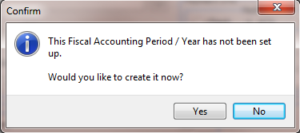
General Company Maintenance
Notes:
Before any entries can be made into the upcoming fiscal year, you’ll need to establish that year in your Accounting Master database.

Slide 4
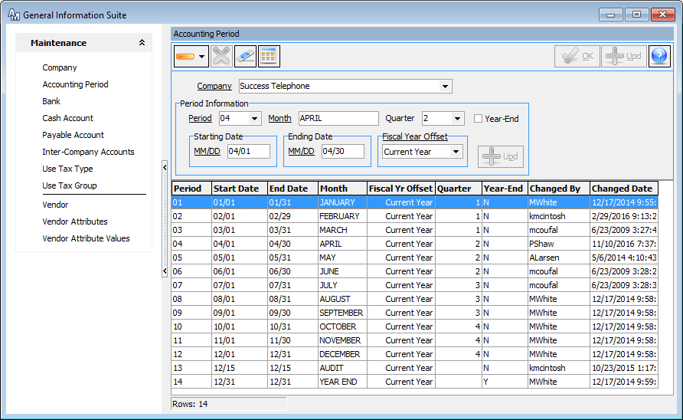
Accounting Period
Notes:
To access the Accounting Period setup screen, go to Packages | General Information | Accounting Period. It can also be accessed from the General Information Suite on the Maintenance Tab.
Without creating the fiscal year, you will not be able to complete a transaction in the upcoming year. An error will appear on every screen until this task has been complete.
The Accounting Period screen is the starting point for every fiscal year. This screen identifies your period structure by GL Company. This structure is present throughout the AM database.
The Starting Date and Ending Date associated to a period represent the month/day that Accounting Master will recognize on all transaction screens.
If using the budgeting feature in Accounting Master, you will have the option of running reports on a quarterly basis. Before this can be accomplished you will need to associate Quarters to a selected period.
If your fiscal year does not correspond with the calendar year, the Fiscal Year Offset will guide the system when creating general ledger reports.

Slide 5
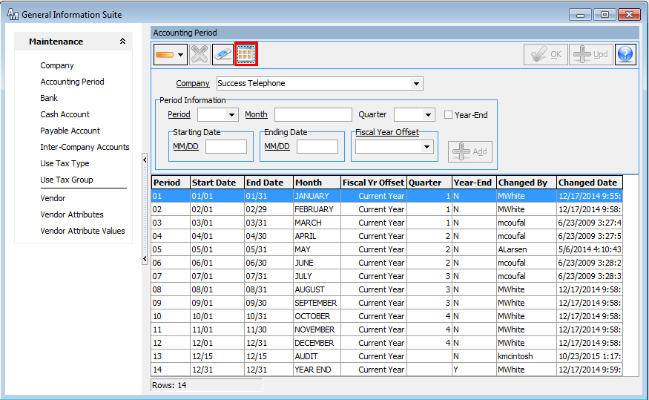
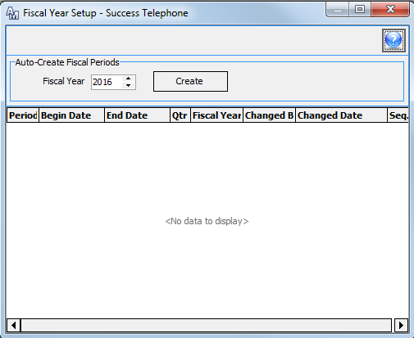
Fiscal Year Setup
Notes:
Creating a fiscal year is performed through the Fiscal Year Setup icon.
The appropriate year must be selected from the Fiscal Year field. The Create button will generate a row for every period associated with that year.
If the rows have been generated in error, a Recreate button will be available to adjust the year.

Slide 6
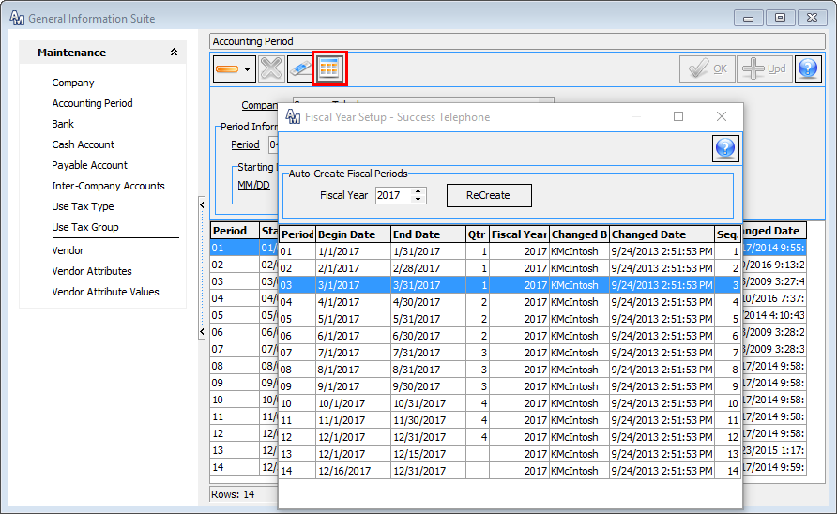
Fiscal Year Setup
Notes:
Once you click Create, the Accounting Periods will populate in the Fiscal Year Setup screen.

Slide 7
Payroll Maintenance
(Maintenance | Company)
(Payroll | Payroll Suite)
Labor Year Setup
Tax Year Setup
Benefit Resets
Benefit Accrual Year Close
(Auto Accrue/Automated Reset)
Benefit Maintenance
(Manual Reset)
Tax Table Updates
Federal Tax Tables
State Tax Tables
Local Tax Tables
Notes:
The following slides include details on yearly maintenance within the Payroll module. Similar to the functionality of the Fiscal Accounting Period setup, this maintenance within Payroll is necessary for the upcoming year.

Slide 8
Payroll Company Maintenance
Labor Year Setup
Notes:
Time Management System (TMS) users will need to establish the upcoming payroll year before employees can begin to access their timesheets. If the year has not been established, an error will given during the entry process on the TMS website.
The Labor Year Setup is also used with the Auto Calculation of Overtime feature. If you’re using either of these features, your Labor Year Setup will need to be completed for the upcoming year.

Slide 9
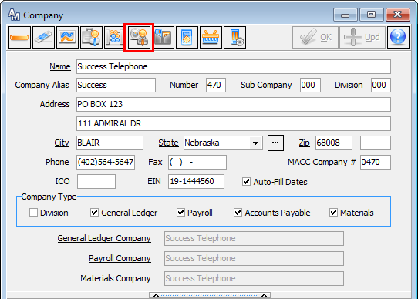
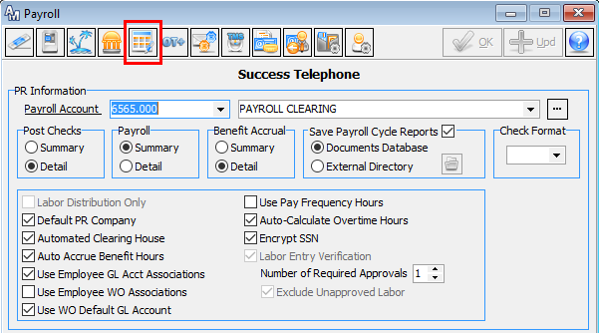
Labor Year Setup
Notes:
To create the upcoming year in the system, go to Packages | General Information | Company. This information is also available from the General Information Suite on the Maintenance tab.
After entering the Company screen, select the appropriate Payroll GL Company to update. The Payroll icon will take you into the payroll options section of this screen. From here, select the Labor Year Setup icon – as indicated above.

Slide 10
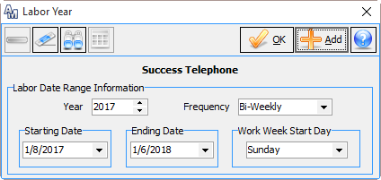
Labor Year
Each Frequency paid will need to be set up and can be unique in date range and start date
Notes:
For every frequency that your company will be using, you will need to establish a Starting Date and Ending date for the payroll year. These are your payroll dates and may not correspond to the fiscal calendar.
Additionally, you will need to identify the Work Week Start Day. This will direct the web how to display the work week to your employees.

Slide 11
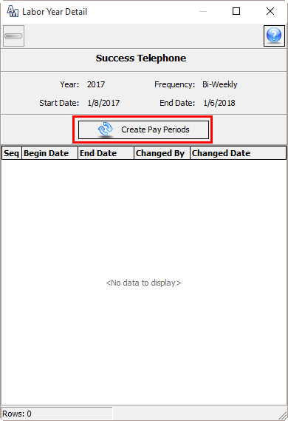
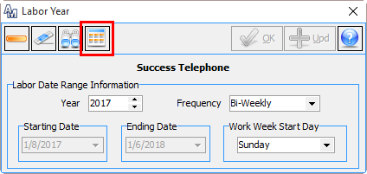
Labor Year Details
Labor Year Details
(pay periods) are
displayed in the grid
Notes:
Before exiting the Labor Year screen, go to the Labor Year Details icon. This function is designed to layout the pay periods for the upcoming year.

Slide 12
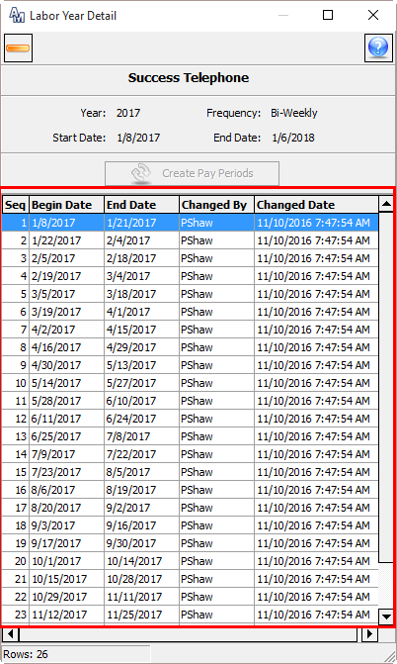
Labor Year Details
Notes:
In the example above, 26 pay periods were generated and correspond to the Bi-Weekly pay cycle.

Slide 13
Payroll Company Maintenance
Tax Year Setup
Notes:
If your company uses the Auto Benefit Accrual Process in Accounting Master, the Tax Year Labor Date Range must be created prior to running the Benefit Accrual Year Process.

Slide 14
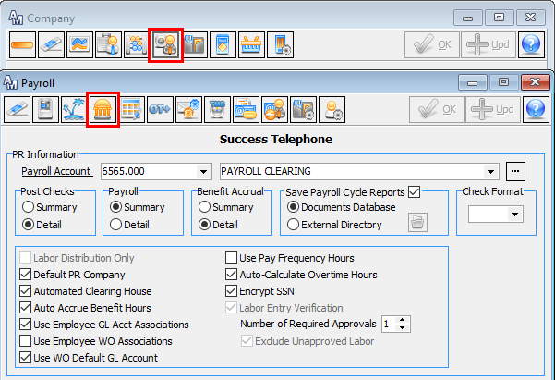
Tax Year Setup
Notes:
The Tax Year Setup screen is accessed from the Company screen, selecting the Payroll Default icon. From the Payroll screen, the Tax Year Labor Date Range icon will need to be selected – as shown above.

Slide 15
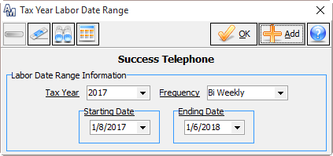
Tax Year Date Range
Each Frequency paid will need to be set up and can be unique in date range
Notes:
You may either enter the upcoming Tax Year, Frequency and Date Range or select the calendar icon at the top of the screen for an automated creation of the year. This must be done before closing your benefit year. After saving the new year, click on the Tax Year Labor Date Range Icon.

Slide 16
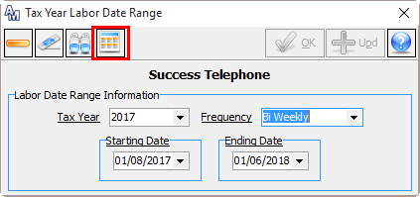
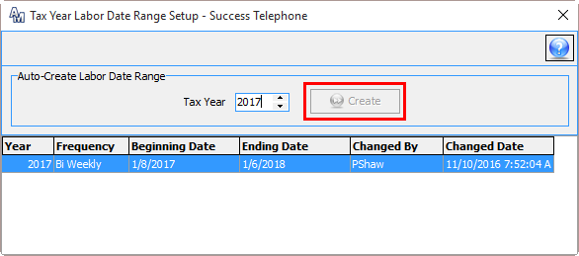
Tax Year Date Range
Notes:
After creating the initial tax year, you can use the Tax Year Labor Date Range Icon to create subsequent Tax Years, based on the data previously entered.

Slide 17
Payroll Maintenance
Benefit Resets
Notes:
Annual employee benefit plans are typically reset at Year-End, depending on your company policy. If you reset your annual plans at Year End, you have two options.
Using the Auto Accrue feature, the system can do the work for you, as you end the previous benefit year, & create the new benefit year, perhaps carrying over left over hours. Auto Accrue not only has an option to accrue a set amount of hours throughout the year, it can also deposit a lump amount of hours into your employee totals, which they’d subtract from throughout the year. Once you’ve completed the initial setup, resetting the benefit year using the Benefit Accrual Year close feature is quick & easy.
The second option to reset your benefit year, aside from the Benefit Accrual Year Close, is manually resetting your year.

Slide 18
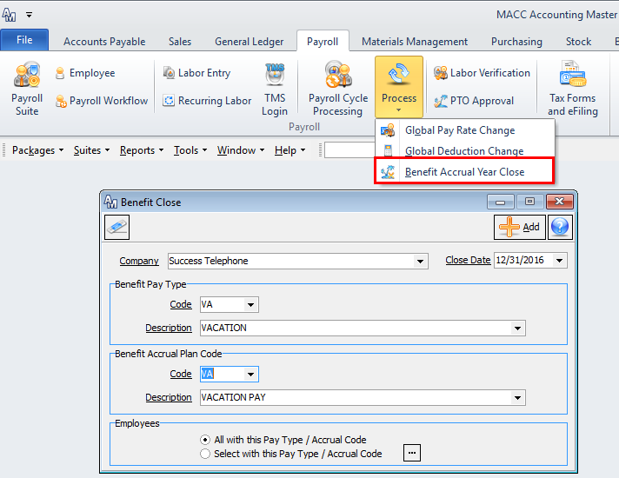
Benefit Accrual Year Close
Notes:
Starting with the Benefit Accrual Year Close, since you have already established the Tax Year Labor Date Range, you can proceed to reset your benefits. To use the Benefit Accrual Year Close Tool to reset benefits that are set to auto-accrue, go to Payroll | Process | Benefit Accrual Year Close or from the Payroll Suite.
From this screen, you will select your Company and the Close Date. The close date should be the last day of your current year’s accrual ending date. If you do not know what this date is, you can find it by going to the benefit maintenance screen and review the current plan.
Choose the benefit pay type that you are closing, and the corresponding benefit accrual plan code.

Slide 19
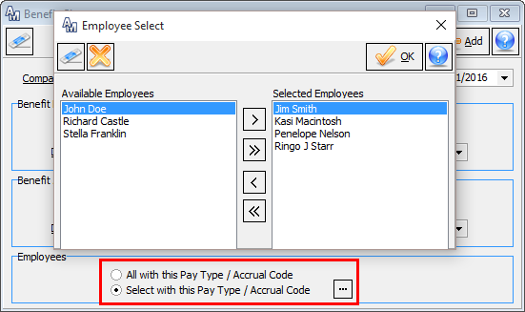
Benefit Accrual Year Close
Notes:
If it’s an annual plan, select the All Employees radio button. If using anniversary plans, choose the Select Employees radio button.
Companies using anniversary benefit plans will run this process every time an employee has met his or her anniversary date.

Slide 20
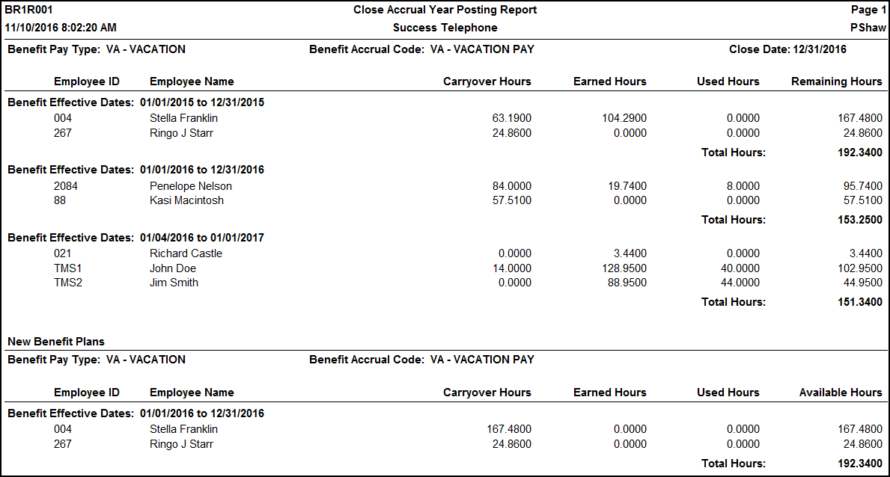
Benefit Accrual Year Close
Notes:
The Close Accrual Year Posting Report will be generated. The report will list employee benefit earnings by benefit accrual code. The top section of the report will give you current details while the bottom shows the new plan moving into the next year.

Slide 21
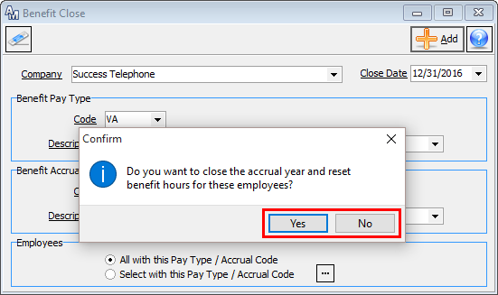
Benefit Accrual Year Close
Notes:
After closing the report, a confirmation message will appear asking if you wish to close the accrual year and reset benefit hours for the reported employees. Selecting Yes will run the process to reset, if you select No, you will return to the Benefit Close screen to make any needed corrections.

Slide 22
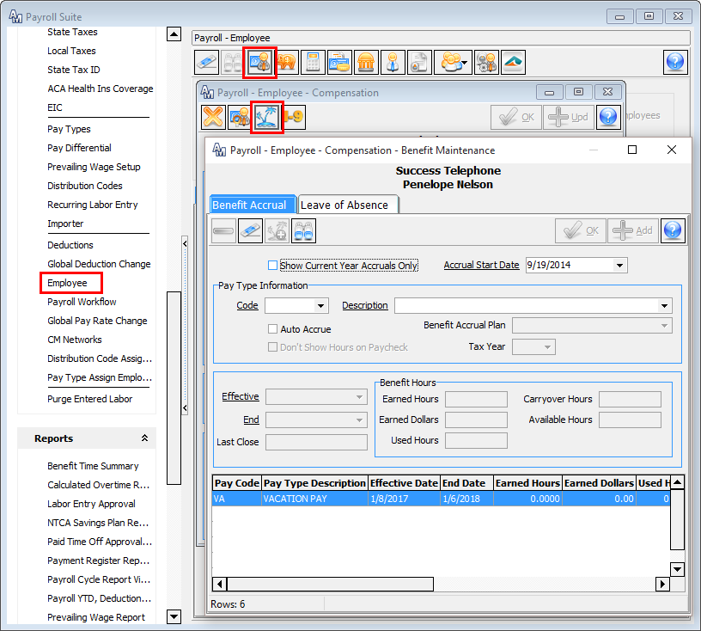
Employee Auto
Reset
Every employee selected from the process will be reset with the new year’s benefit plan
Notes:
To verify that the process was successful, you can go to the Employee Benefit Maintenance screen. A new row should be present for all the benefits closed through the process. This row will display the upcoming year and its tax year labor date range. If your plan allows carryover hours – you will see the carryover value accordingly.
**Hours for the new year will not be earned until the first payroll cycle processing of the new year.

Slide 23
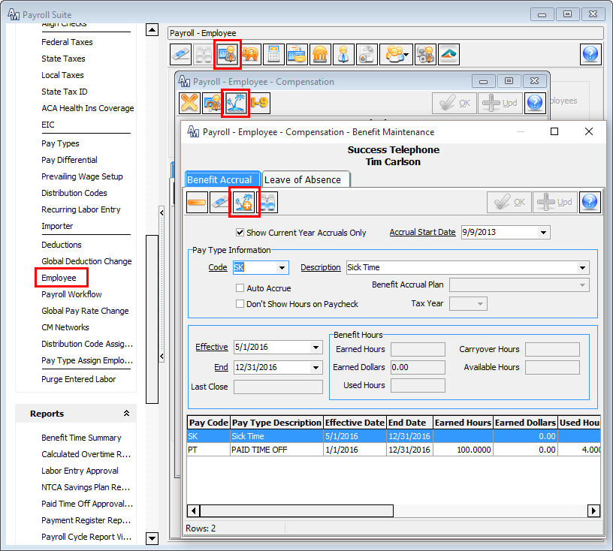
Benefit Manual Reset
Notes:
If you are not using the auto accrual function in Accounting Master, benefit hours will need to be manually reset for each employee. To do this, you will need to go to Packages | Payroll | Employee or from the Payroll Ribbon Tab.
From the Employee screen, choose your employee and select the Compensation icon. This will bring up the Compensation screen where you will click on the Benefit Maintenance icon.
On the Benefit Maintenance screen, select a benefit pay type for this employee and enter the effective and ending dates. Click Add at the top of the screen when finished.

Slide 24
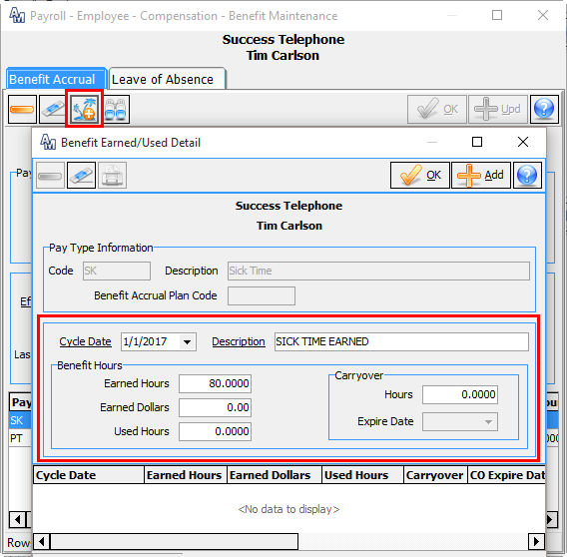
Benefit Earned/Used Detail
Notes:
To enter benefit detail hours for this employee, select the row you just created by double-clicking or right-click and update. Then click on the Benefit Earned/Used Detail icon at the top.
From the Benefit Earned/Used Detail screen, enter a cycle date (the date in which the hours are effective) and a description for the hours. Then enter any Earned, Used or Carryover hours.
This process will need to be completed for each benefit assigned to the employee.

Slide 25
Payroll Maintenance
Tax Table Updates
Notes:
Prior to running the first payroll of the year, your tax tables for the upcoming year will need to be updated.
The Accounting Master Software Support team will pass along the current known tax information. We strongly recommend that you review this information carefully and compare it to your most recent tax information. Although MACC works to keep informed of all current tax rates, it’s important that you analyze this information for accuracy as we are not liable for anything that may have been overlooked. Please keep in mind that we are not tax advisors. You will want to carefully review the information and confirm its accuracy with your tax experts.

Slide 26
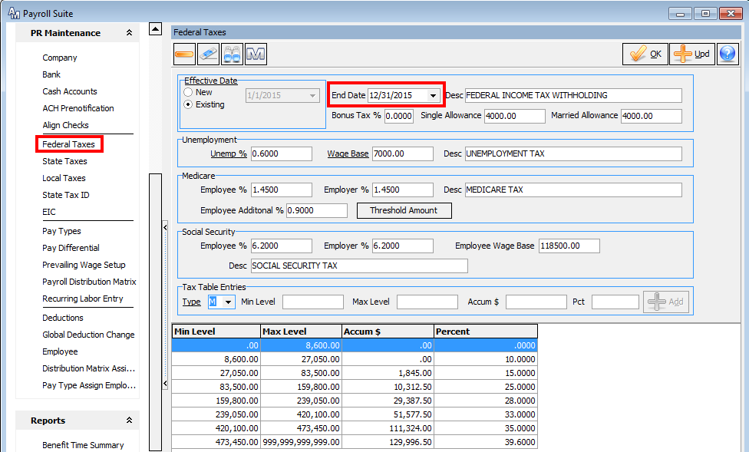
Federal Tax Table Updates
Notes:
To access the tax tables go to Packages | Payroll | Tax Tables | Federal. This information may also be accessed from the Payroll Suite.
It is important to first outdate the current tables before entering the new year’s changes. To outdate a tax table, recall the current effective date and place a date in the End Date field.

Slide 27
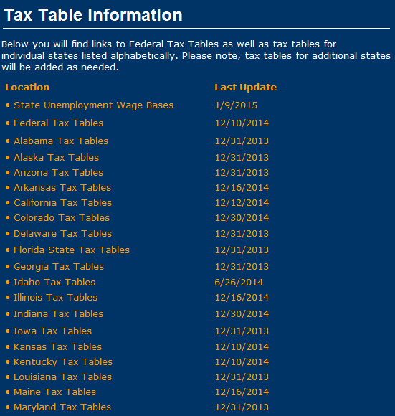
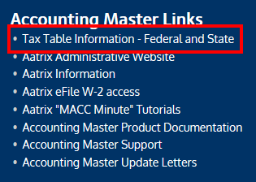
Tax Table Information
Notes:
A new icon has been added to the Tax Table screens. In the past, a MACC Accounting Master representative would send you tax updates and changes. Now you can click on the “M” icon and be directed to a MACC web site that contains all changed Federal and State tax tables.

Slide 28
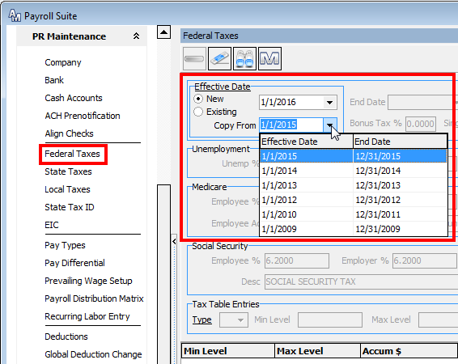
Federal Tax Table Updates
Notes:
You can copy a prior year’s tax tables & make updates as needed. Click on the ‘New’ effective date button. Enter a new Beginning Date for the tax table to be created.
From the ‘Copy From’ dropdown, select the tax table you want to copy for the new year.

Slide 29
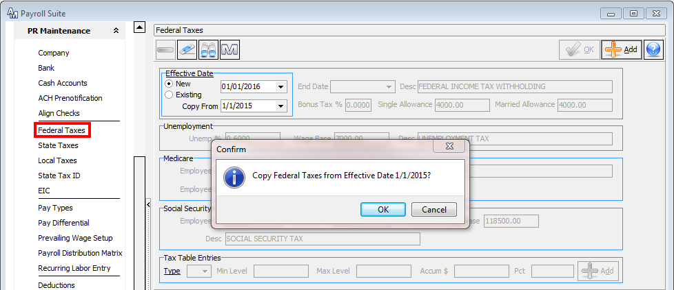
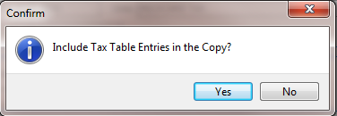
Federal Tax Table Updates
Notes:
After you have chosen a year to Copy From, click on the Add button. You will be asked if the year you have chosen is the correct year to copy. If you have chosen the correct year, click on ‘Yes’.
Once you select Yes, you will be asked if you want the Tax Table Entries copied as well. By answering ‘Yes’, the system will create tax table entries as seen in the next screen shot.
If the tax table entries have changed dramatically, you may want to say ‘No’ and enter the new tables entirely. If you prefer to copy the tax table entries, click on “Yes”.

Slide 30
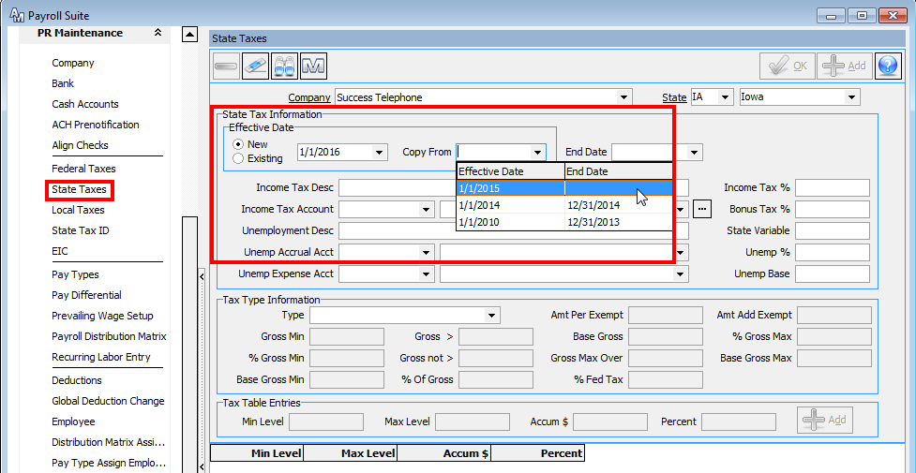
State Tax Table Updates
Please check with the MACC web site link provided AND your state government regarding state tax changes
Notes:
If necessary, you may also need to update your state tax tables. To do this go to Packages | Payroll | Tax Tables | State. This may also be accessed from the Payroll Suite
Similar to the federal tax tables, it is important to first outdate the current state tax tables before entering the new year’s changes.
At the State Tax screen, you have the same opportunity as the Federal Table to copy an earlier tax screen. (See next slide)
Your Accounting Master Software Support Representative will send updates, but please check your state website to verify all changes have been identified. Additionally, as you become aware of state changes, notify AM support for verification of the change.
The Unemployment % will need to be filled in and is unique to your company. This information will be provided to you by your state.
If copying a tax table from a prior year, click on the Effective Date New option. Enter a new begin date for the tax table to be created. From the Copy From dropdown, choose the prior tax table you wish to copy.
Click on the Add button to record the copy process.

Slide 31
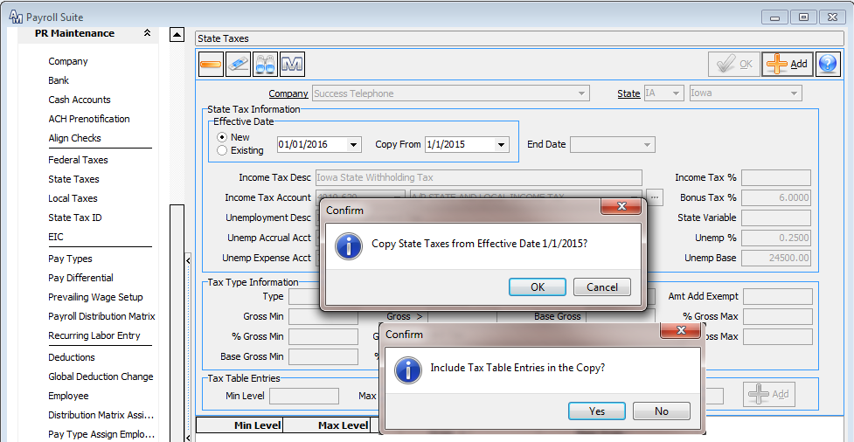
State Tax Table Updates
Notes:
Upon clicking the Add button, you will be asked if you want to Copy State Taxes from Effective Date 01/01/2014.
Upon clicking the Add button, you will be asked if you want to copy the existing Tax Table Entries. If the tax table entries have changed dramatically, you may want to say ‘No’ and enter the new tables entirely. If you prefer to copy the tax table entries, click on “Yes”.

Slide 32
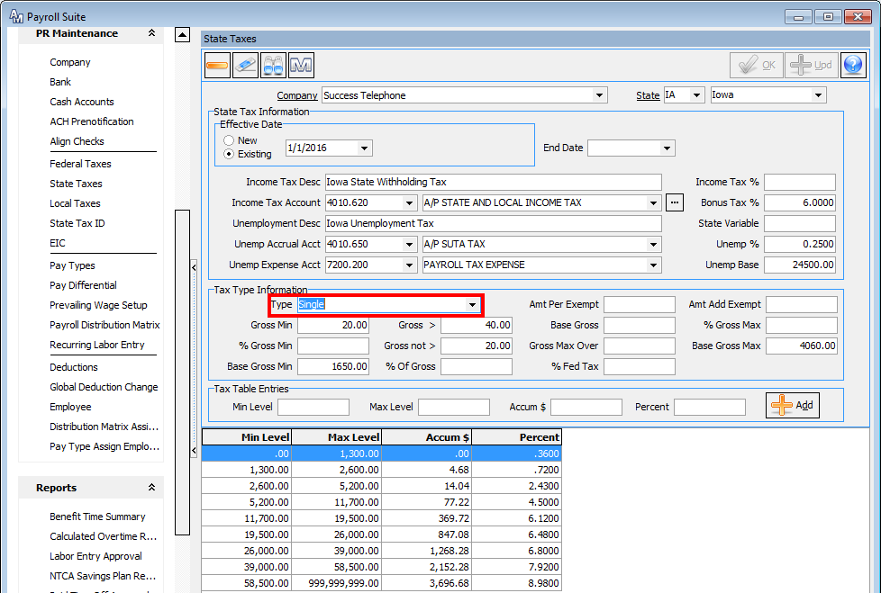
State Tax Tables
Notes:
From the Tax Type Information, choose the Type in the dropdown. After you have made your adjustments, click on the Update button. If necessary, choose the other options of Types that need to be changed.

Slide 33
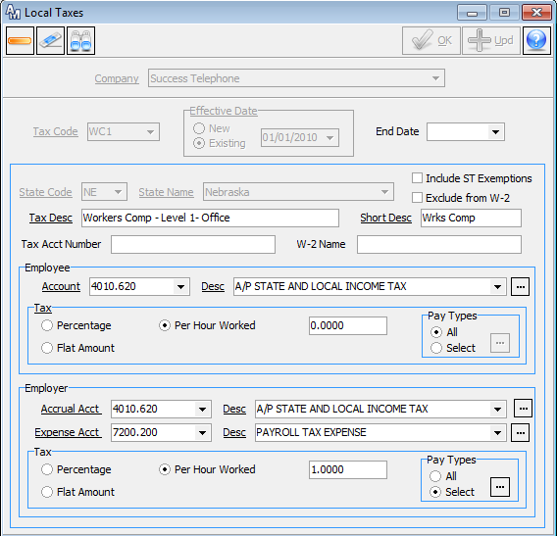
Local Tax
Table Updates
Please check with your local authorities regarding any local tax changes
Notes:
If your company is withholding local taxes, the Local Tax Table may also need to be updated. To access the Local Tax Table go to Packages | Payroll | Tax Tables | Local. This information may also be accessed from the Payroll Suite.
MACC will not be informed of local tax changes, please check with local authorities to see if changes need to be made.

Slide 34
Payroll Maintenance
Helpful Reminders
Employee Compensation Increases
Payroll | Payroll Suite | Employee – Compensation – Compensation Detail
Employee Deduction Rate Changes
Payroll | Payroll Suite | Employee – Employee Deduction
Payroll | Payroll Suite | Global Deduction Change
Company Deduction Plan Changes
Payroll | Payroll Suite | Deductions
Notes:
At year-end, companies also commonly revise their employee compensation and/or deductions. For compensation increases, the Compensation Detail screen has to be updated in the Employee screen, under Compensation – Compensation Detail.
To update your employee deduction setup, there are two options. You can update each employee individually in the Employee screen, under Employee Deductions. To update more than one employee at a time, the Global Deduction Change tool makes the process quick & easy. This is found in the Payroll Suite, under Global Deduction Change.
If needed, to update your deduction setup entirely, the Deductions screen is located in the Payroll Suite, under Deductions.

Slide 35
Reports
Helpful Reports to Run Prior to Close
Trial Balance Report
Outstanding Invoices – AP/AR
Batch Posting AP/AR/IN
Payroll YTD, Deduction, Tax Reports
Work Order Analysis
Aged Trail Balance – AR
Notes:
The reports listed above are useful reports to run before you run your year-end close. All of the reports may not be applicable, depending on which modules your company utilizes.
Trial Balance Report – Run this report before you do your Period 13 close. Make sure only Period 13 entries are posted. You may run this report as many times as desired. This will also be viewable through the Period Close Processing.
Outstanding Invoices AP/AR – Run an invoice search of all outstanding invoices, verify that they are posted to the correct period and if they should have been paid or received.
Batch Posting AP/AR/IN – Make sure you have no items that need to be posted. No items should be posted to 13, or 14.
Payroll YTD, Deduction, Tax Reports– It’s helpful to check your Payroll Reports before processing your W-2s.
Work Order Analysis – Check to see if all work orders applicable are closed and that amounts have been allocated to the proper GL Accounts. This can be completed through the Work Order Close process or manually though the Journal Entry screen.
Aged Trial Balance AR – Past due amounts may need to be written off and posted prior to close.

Slide 36
General Ledger Maintenance
Period 13 Period Processing
Period 14 / Year End Close
Re-Open a Closed Period/Year
Notes:
Once you’re ready to finalize your General Ledger for the year, closing out Period 13 and Period 14 is your next step.
Period 13 is typically used for audit entries, this period is set aside from your fiscal year for audit entries. Your auditors will use this period to enter any adjusting or audit entries for the year.
Period 14 is typically used for year end processing. No entries should be posted to this period, aside from the Year End Closing Entries, generated from the Year End process.
If necessary, you may re-open a closed period/year using the Re-Open a Closed Period tool in the General Ledger Suite.

Slide 37
General Ledger Maintenance
Period 13 - Audit
Notes:
Period 13 is typically reserved for audit entries given to you by your auditor. Closing Period 13 is similar to closing Periods 1-12, without posting recurring or depreciation journal entries.

Slide 38
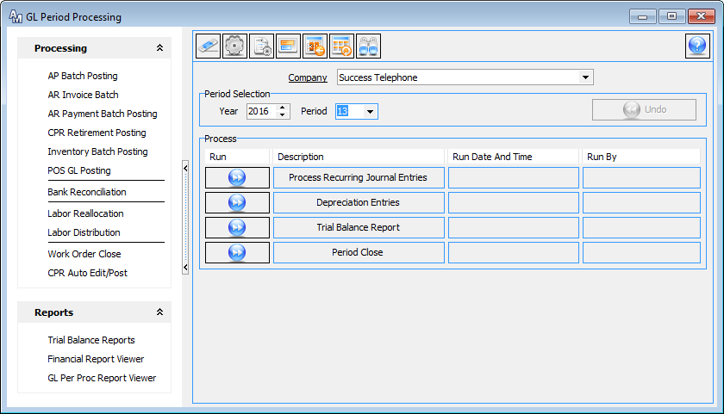
Period 13 - Period Processing
Do not run Step 1 and 2 when closing Period 13
Notes:
To access the closing process go to Packages | General Ledger | Processing | Period or from the General Ledger Suite.
If you don’t have your audit entries before the end of January and would like to view a preliminary financial, you can close Period 13 temporarily. When the audit entries have been received you can re-open this Period and make any entries needed.

Slide 39
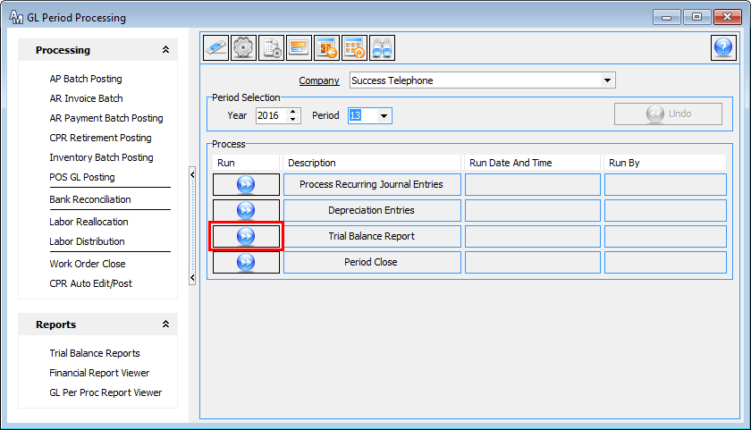
Period 13 - Period Processing
Do not run Step 1 and 2 when closing Period 13
Notes:
When closing Period 13, DO NOT run steps 1 and 2. Recurring entries and depreciation entries do not need to be processed in this Period. Skip to step 3.
The Trial Balance Report for this Period should only reflect the audit entries - no other entries should be posted to this Period.

Slide 40
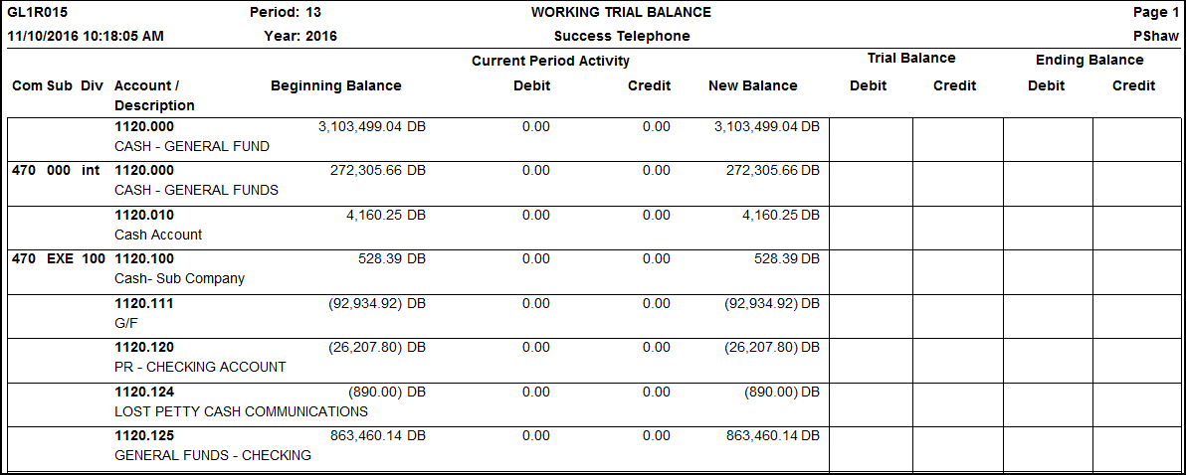
Working Trial Balance
Notes:
The Working Trial Balance will display your beginning balance, activity, & your new balance. This is what will be forwarded to Period 14.

Slide 41
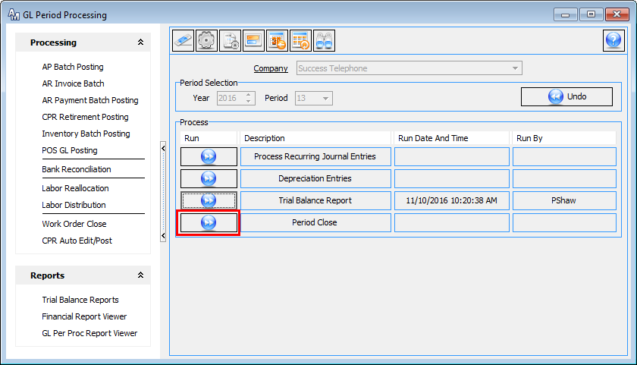
Period 13 - Period Processing
Notes:
Select Step 4, Period Close.
Once a period has been closed, financial reports can be generated for the period. Now you are ready to close Period 14 through the Year-End Processing.

Slide 42
General Ledger Maintenance
Period 14 – Year End
Notes:
Period 14 is typically used for the Year End entries, & is closed out differently than the rest of your periods. Do not use the Period Processing screen for Period 14. Instead, it’s closed through the Year End screen in the General Ledger Suite.

Slide 43
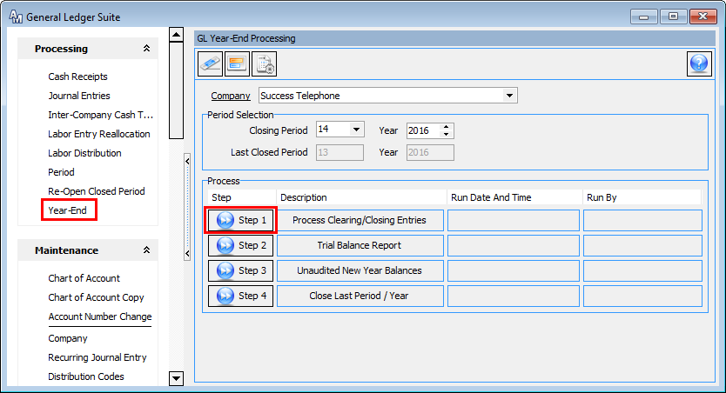
Period 14 - Year-End Procedures
Notes:
It’s a good idea to close the year soon after the new year begins. This will ensure that nothing will be posted into the previous year and/or the wrong period. The location for this is Packages | General Ledger | Processing | Year End. It may also be accessed from the General Ledger Suite.
In order to close the year, Period 13 must be closed. Steps 1 through 4 must all be run - you cannot skip any steps in this process.
This process will bring all of the account balances forward to the new year.

Slide 44
Period 14 – Process Clearing/ Closing Entries
Notes:
Step 1 of the process will generate a Journal Entry Posting Report. This report will take all accounts with the type of expense or revenue and zero them out. At the end of the report you will see an offsetting entry into your Retained Earnings Account. This will state your net income for the year.

Slide 45
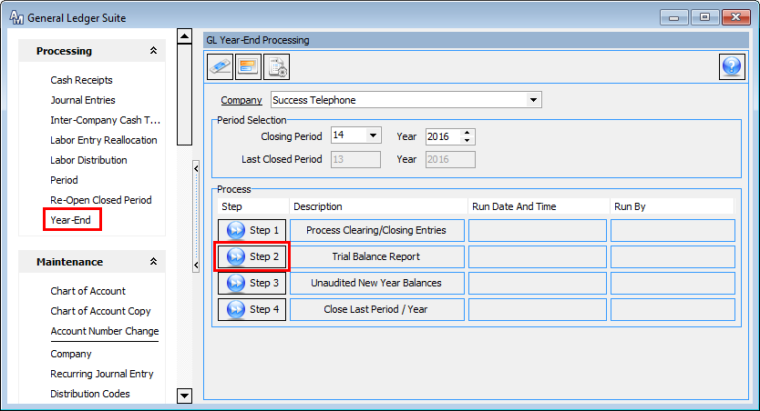
Period 14 - Year-End Procedures
Notes:
Run Step 2.

Slide 46
Period 14 – Working
Trial Balance
Notes:
Step 2 will generate a Working Trial Balance Report for your review.

Slide 47
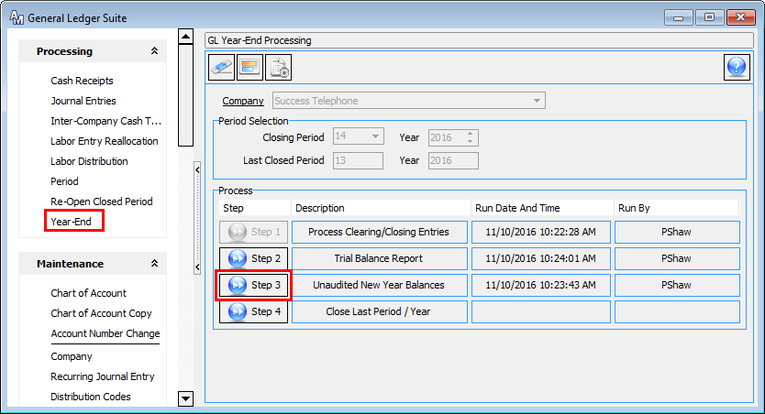
Period 14 - Year-End Procedures
Notes:
Step 3: Unaudited New Year Balances – this step will carry balances forward for reporting purposes and any last-minute entries. This step will not produce any reports.

Slide 48
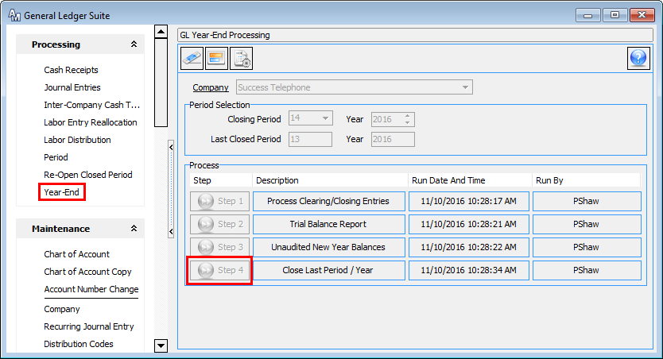
Period 14 - Year-End Procedures
Notes:
Step 4: Close Last Period/Year – this is the final step in the process. Clicking the Step 4 button will close the year. This step will not produce any reports.

Slide 49
General Ledger Maintenance
Re-Open a Closed Period/Year
Notes:
Sometimes it is necessary to re-open a closed period or year. Accounting Master includes a tool to quickly & easily re-open your periods or years.

Slide 50
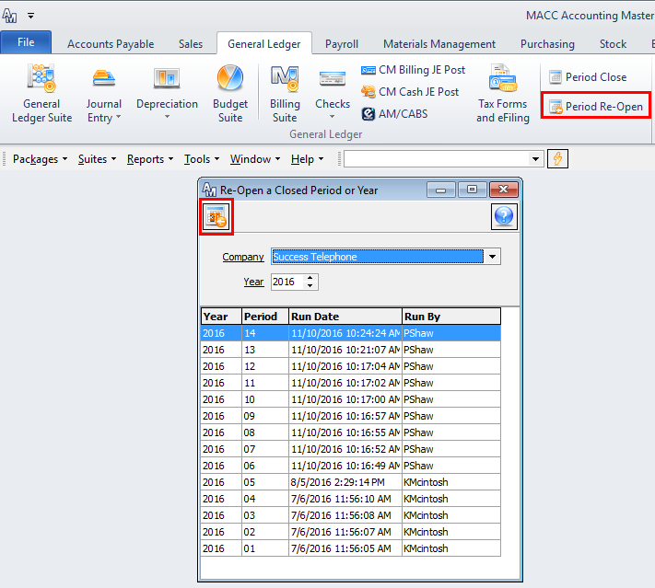
Re-Open Closed Year
Notes:
Once a year has been closed, it can be reopened through the GL module. This is particularly helpful if your audit entries are not received until the next year. The location for this is Packages | General Ledger | Processing | Re-Open Closed Period or from the General Ledger Suite.
To reopen a year, first select the year you wish to reopen. In the upper left had corner of the screen select the Re-Open Year icon.
A warning will appear, asking you if are sure you want to open the selected year. If the year is correct, select Yes.

Slide 51
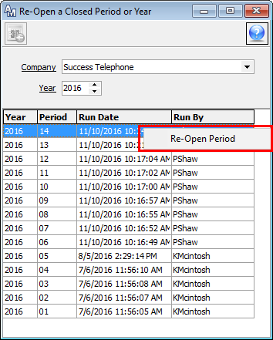
Re-Open Closed Periods
Notes:
You can open closed Periods from this screen as well. Right click with your mouse on the closed Period from the grid you want to reopen. This process will open step 4 of the Period Processing steps. Recurring entries and depreciation entries will not be affected by this process.

Slide 52
Tax Form Processing Options
Complete Service
MACC Complete Service
Self Printing & Filing
Notes:
MACC offers three different tax form processing options for your convenience, each available using your Accounting Master software. You can choose to print & file your tax forms yourself, or you can use a Complete Service option, which utilizes the assistance of our trusted partner, Aatrix.
MACC Minute tutorials are available online, at http://www.maccnet.com/accounting/. These step-by-step tutorials walk you through tax form processing, whether you’re printing & filing them yourself, or using the Complete Service.
Email reminders will be distributed in the coming weeks, keeping you informed of your options. Regardless if you are using one of the Complete Service Options, ordering forms only from MACC, or handling everything without forms or assistance from MACC, we will need to hear from you. Whether it’s placing your forms or MACC Complete Service order, or letting us know that you’re using the Complete Service on your own, or processing your forms elsewhere, we’d like to ensure that we’re fully prepared should you need assistance or forms from us.

Slide 53
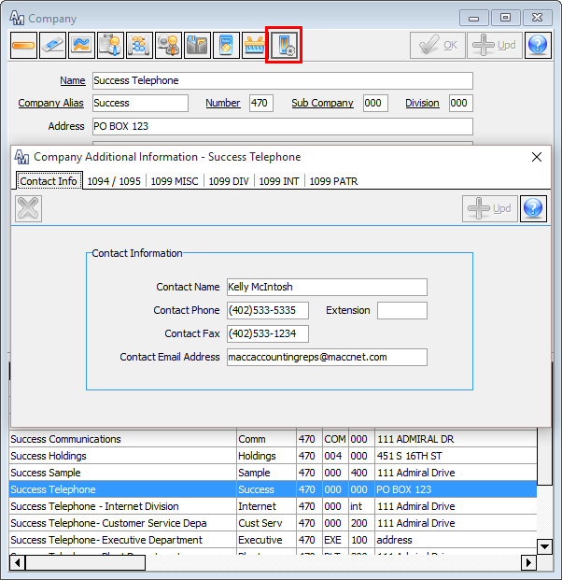
Notes:
The Company Additional Information screen is available from the General Information | Company screen.
This screen is designed to hold default information for tax processing as well as pertinent 1099 minimum information.
Contact Information
At this tab enter default contact information for the Accounting Master tax processes that are completed from the Tax Forms and eFiling screen. Any Form Type (W-2, 1099, etc.) from the Tax Forms and eFiling screen that allows contact information to be entered will reference this default data. If needed this information can be edited during processing.

Slide 54
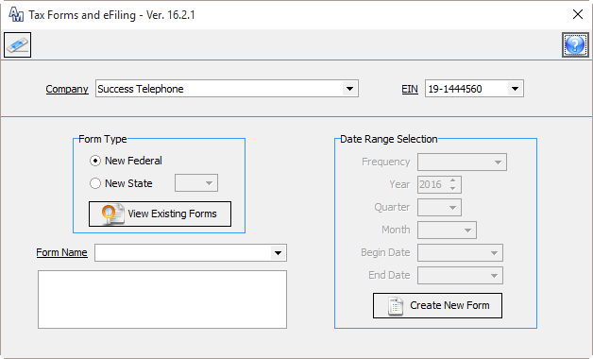
Tax Forms and eFiling
Notes:
Use the Tax Form Selection screen to select a specific set of data for tax processing. All tax processes from Accounting Master will start from the Tax Form Selection screen.
This screen can be accessed from various locations throughout Accounting Master with limited security to forms. For example, when accessed through the Accounts Payable Ribbon, only recipient type forms (1099/1096) will be available for selection. The Tax Form Selection screen can be accessed from the following locations:
Maintenance Ribbon: Tax Section
Accounts Payable Ribbon
Accounts Payable Suite
General Ledger Ribbon
Billing Suite
Payroll Ribbon
Payroll Suite
Stock Ribbon
Stock Suite
Main Menu: Tools

Slide 55
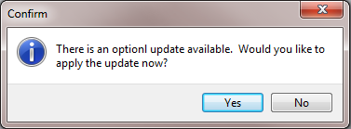
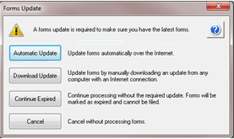
Tax Forms and eFiling
Notes:
Form Updates
When selected, before the screen is opened, the system will check for updates. If mandatory updates are needed a message will appear asking if you wish to apply them. If you select no, the Tax Form Selection screen will not open. If you select yes, the Forms Update screen will appear.
From the Forms Update screen, choose the Automatic Update option. If you do not have rights to download the update from the Internet or write to the install location, you will not be able to complete the automatic updates. If needed, you can download updates manually or continue with expired forms.
If there are no new updates, the Tax Form Selection screen will open automatically.
Help - Helpful ‘Help’ resources are available as you step through the wizard, using the Help icon in the upper right hand corner of each screen.

Slide 56
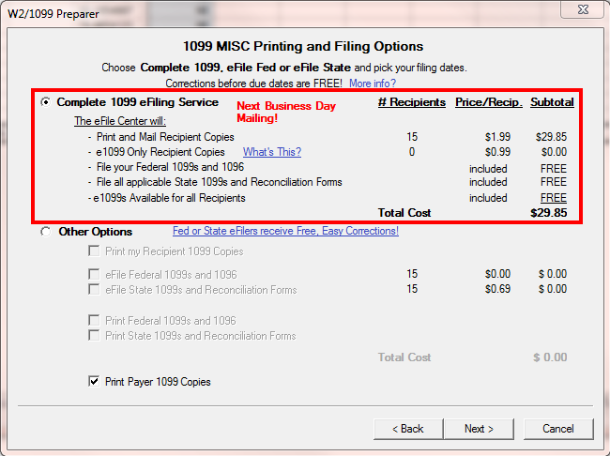
Aatrix Complete Service
Complete eFile Service Includes:
Recipient Forms Printed & Mailed (Postage Included)
Federal Forms
State Forms or reconciliation form
W-2/1099s are eFiled to the appropriate State & Federal Agencies
and printed and mailed directly to your employees or recipients.
Notes:
The Complete Service option allows you to work smarter, not harder, by printing, mailing, and filing your forms. You simply submit your data through the step-by-step wizard within Accounting Master. Once complete, Aatrix/MACC takes care of the rest. No running to the printer, tearing apart perforated pages, or stuffing envelopes. Plus, postage is included!
The Complete W-2 eFiling Service includes the following actions by the eFile Center:
Print and Mail Employee Copies
File the Federal W-2s and W-3 to the SSA
File the State W-2s and Reconciliation Forms
Upon completion of the electronic submission, you will have access to provide your employees with the following:
Online W-2s Available for All Employees
eW-2 Only Employees access letters
This option is the best value and allows submissions of corrections for free before the filings are submitted to the agency by the eFile Center.

Slide 57
MACC Complete Service
W-2/1099s are eFiled to the appropriate State & Federal Agencies
and printed and mailed directly to your employees or recipients.
MACC Complete Service Includes:
Recipient Forms Printed & Mailed
(Postage Included)
Federal Forms
State Forms or reconciliation form
Payer Forms
Notes:
If you’d prefer, you can sign up for the MACC Complete Service, where we’ll submit your information to Aatrix on your behalf, through your Accounting Master database. We will still need your company to verify tax reports for us before we can submit your information to Aatrix. Same options as the Aatrix Complete Service, but MACC completes the steps for you, at an hourly rate.

Slide 58
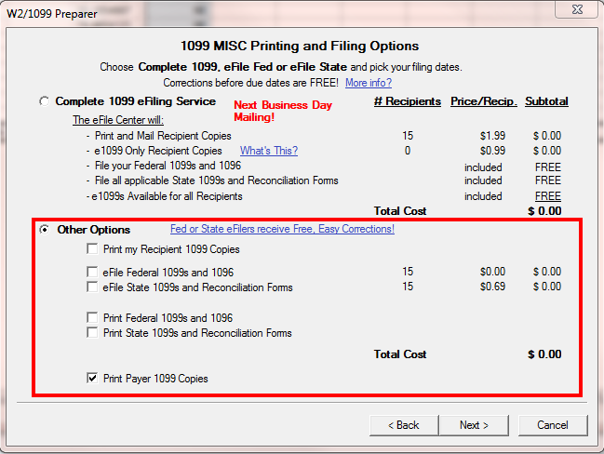
Self-Printing & Filing
You Print, Mail, & File Your Own Forms
Order Forms through MACC or Purchase Locally
You process your 1099s and/or W2s through Accounting Master with Aatrix Interface.
Notes:
If you do not want to go with the Complete eFile Service, there are other options available. Pick one or a combination of these options:
Print my recipient copies
eFile Federal tax forms and transmittals
eFile State tax forms and Reconciliation Forms
Print Federal tax forms and transmittals
Print State tax forms and Reconciliation Forms
Print Payer copies
Mix and match any of the options above. For example, print employee copies but eFile the Federal and State copies.
If printing and filing your own forms, MACC’s 2016 tax form ordering deadline is October 31st.

Slide 59
Affordable Care Act
1094/1095-C or 1094/1095-B
Notes:
The IRS has completed and approved the final versions of the Affordable Care Act form 1094/1095-C or 1094/1095-B. MACC has partnered with Aatrix and will support both sets for the end of the year reporting requirements.
**Please note: Not all MACC customers will be required to file a 1094/1095-C or 1094/1095-B, please review your company situation with your tax advisor or health insurance provider before completing these forms

Slide 60
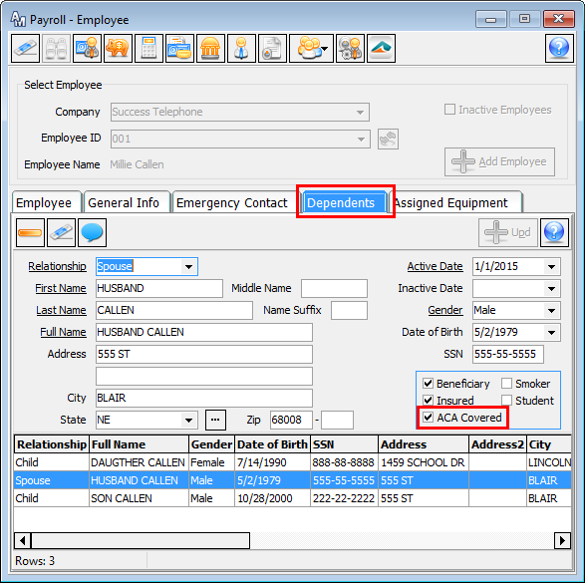
Affordable Care
Act
Notes:
Employee Dependents:
Dependents that are covered for ACA reporting by the selected employee will need to be added & marked appropriately on this screen. If ACA Covered is flagged, the dependent will appear in the appropriate covered individuals section on the 1095 Tax Form.

Slide 61
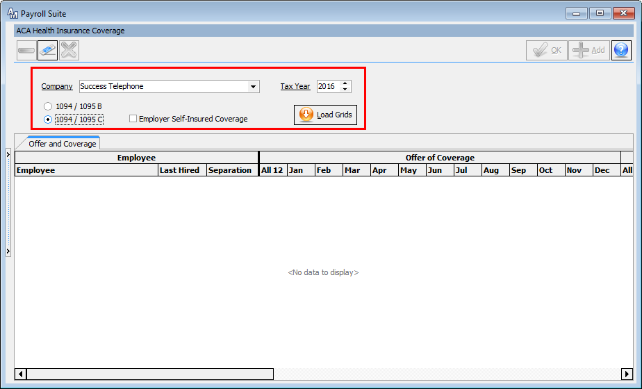
Affordable Care
Act
Notes:
Use the ACA Health Insurance Coverage screen to enter and maintain company and employee information for year-end Affordable Care Act Reporting. This information will be used for tax processing through the Tax Forms and eFiling screen in Accounting Master. Additional entry and/or editing of 1094/1095 forms can be done within the Forms Viewer window of the Tax Forms and eFiling process as desired.
Instructions:
Company: Select a Payroll Company from the drop-down.
Tax Year: Select a tax year for the work table. The system will default to the current year unless the current month is January in which the tax year will default to the previous year. Use the arrows to select the appropriate year.
If data already exists for the selected tax year the form options will be disabled. Select Load Grids to access the saved data for the selected year.
1094/1095 B and 1094/1095 C: Select the Affordable Care Act form you are filing for the selected Payroll Company. The forms selected will determine what information is available in the grid.
Once selected for a given tax year the tax form designation cannot be changed unless you delete the entire table for the tax year. To delete a tax year you must select the delete icon in the toolbar.
Please consult your tax advisors on which forms are required to be filed for your company.

Slide 62
Affordable Care
Act
Notes:
1094/1095 B and 1094/1095 C Continued:
When 1094/1095 B forms are selected only the Covered Individuals tab will be available in the grid.
When 1094/1095 C forms are selected the Offer and Coverage tab will be available in the grid.
If Employer Self-Insured Coverage is checked the Covered Individuals tab will also be available in the grid.
Employer Self-Insured Coverage: This option will be available if the 1094/1095 C tax forms are selected. Place a checkmark in this field if the selected payroll is employer self-insured.
Load Grids: Select this button to load the applicable grid work tables based on the selected tax forms.

Slide 63
ACA – Covered Individuals
Notes:
Covered Individuals Tab
The Covered Individual tab will be automatically loaded with employees for the selected payroll company who were active for at least part of the selected tax year. Dependents for those employees that are marked as ACA Covered on the Employee Dependent screen will be included if they were active for at least part of the selected tax year. Dependents will appear directly below the employee and will be displayed indented in the column.
Last Hired Date will be populated for each employee. This value will not be populated for dependents of an employee. If the employee left the company within the tax year the separation column will be populated with the separation date from the Employee Compensation screen in Accounting Master.
The Social Security Number (SSN) and Date of Birth (DOB) columns will populate for both the employee and dependent if the information is available in Accounting Master. (Employee Compensation Screen, Employee Human Resource Screen and Employee Dependent Screen.)

Slide 64
ACA – Covered Individuals
Notes:
Coverage Checkboxes – For each employee and/or dependent listed in the grid place a checkmark in the appropriate boxes in which the employee or dependent falls into the 'covered' category for each month of the year.
Place a checkmark in the All 12 checkbox to automatically check each individual month. If at least one month is unchecked the All 12 checkbox will automatically be unchecked as well.
By default the system will check the coverage months based on the employees' last hire date and separation date (dependents will be based on active and inactive dates). If they were active at any point during a given month, that month will be checked. Review in detail each employee and/or dependent and make any adjustments as applicable for your payroll company or health insurance plan.
Use the column header to select/deselect all boxes for an entire column - making the change for all employees.

Slide 65
Affordable Care
Act
Notes:
The right-click menu from this grid will have the following options available.
Select All: Choose this option to select all visible rows in the grid.
Apply to Selected: This option will be enabled if more than one row in the grid is currently selected. Choose this option to apply all values for the focused row to all other selected rows. Use the CTRL and ALT keys to select multiple rows in the grid.
Exclude: Choose this option to remove an employee and all associated dependents from the grid. Selecting to exclude an employee will also remove them from the Offer and Coverage grid, if it is applicable. Employees that are excluded from the grid will not be included in forms creation process through Tax Forms and eFiling.
Include Previously Excluded: Choose this option to access the Include Previously Excluded screen. This screen will contain all employees that were active during the selected tax year that have previously been excluded from the Covered Individual or Offer and Coverage tabs

Slide 66
ACA – Coverage
Options
Notes:
Coverage Options – Additional options available on a per employee basis are Other Coverage Provider and Origin of Policy. These values can be selected individually as needed. If desired you may set a default for the company at Company | Company Additional Information.
Other Coverage Provider: This drop-down will be based on pre-established Other Coverage Providers entered from the Company Additional Information on the ACA Other Coverage Provider Screen.
Origin of Policy: This drop-down will be based on ACA guidelines and the following selections will be available.
Small Business Health Options Program (SHOP)
Employer-sponsored coverage
Government-sponsored coverage
Individual market insurance
Multi-employer plan
Miscellaneous minimum essential coverage

Slide 67
1094/1095 Additional Options
Notes:
1094/1095 - Company | Company Additional Information.
At this tab select the tax processing year for the selected Company from the Year field. Below the year enter the default Origin of Policy and Other Coverage Provider. These defaults will be used to populate the Origin of Policy and Other Coverage Provider fields in the Covered Individuals section of both the 1094 and 1095 forms. If no default is established and you are required to fill out this portion of the form it can be selected from the ACA Health Insurance Coverage screen.
To add a new Other Coverage Provider select the ellipsis to the right of the field.

Slide 68
eFile 1094/1095
Options
Notes:
In addition, make ACA reporting simple, fast, and accurate using the Aatrix ACA eFile Service which will include mailing of employee copies. The Aatrix eFile Service is guaranteed to be on time and in the format required by the Federal Government.

